Slide 1
Remove duplicates from linked list
23/07/27

Slide 2
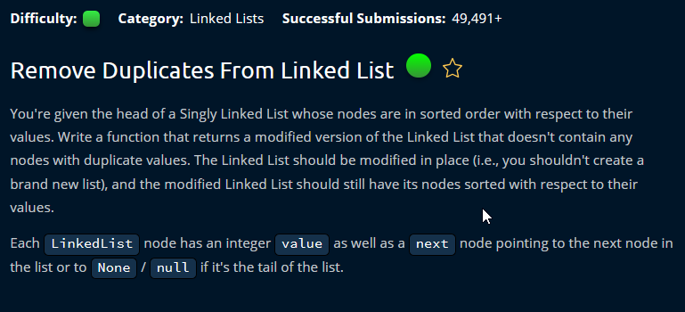

Slide 3
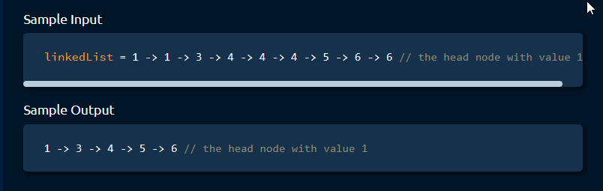

Slide 4
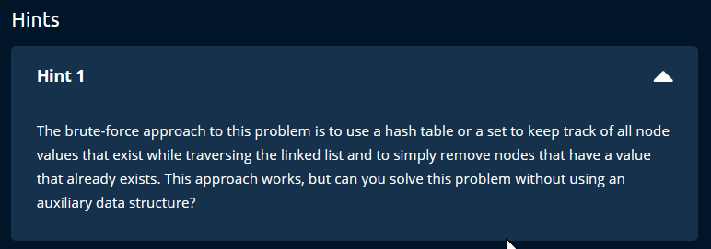

Slide 5
Question Analysis
Sorted Linked List
It is important that the given LL is sorted.
Since the link is sorted we only need to check the next node and the current node and skip if they are equal without using any extra space leading to space O(1).
Can also be solved using the axillary data structure but space will become O(N)
Unsorted Linked List
If the list is unsorted the only possible solution would be building a dictionary to store individual which will make the space to be O(N).
Or we need to compare every node with every other node which will lead to time O(n^2)

Slide 6


Slide 7
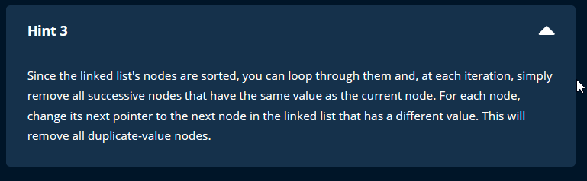

Slide 8


Slide 9
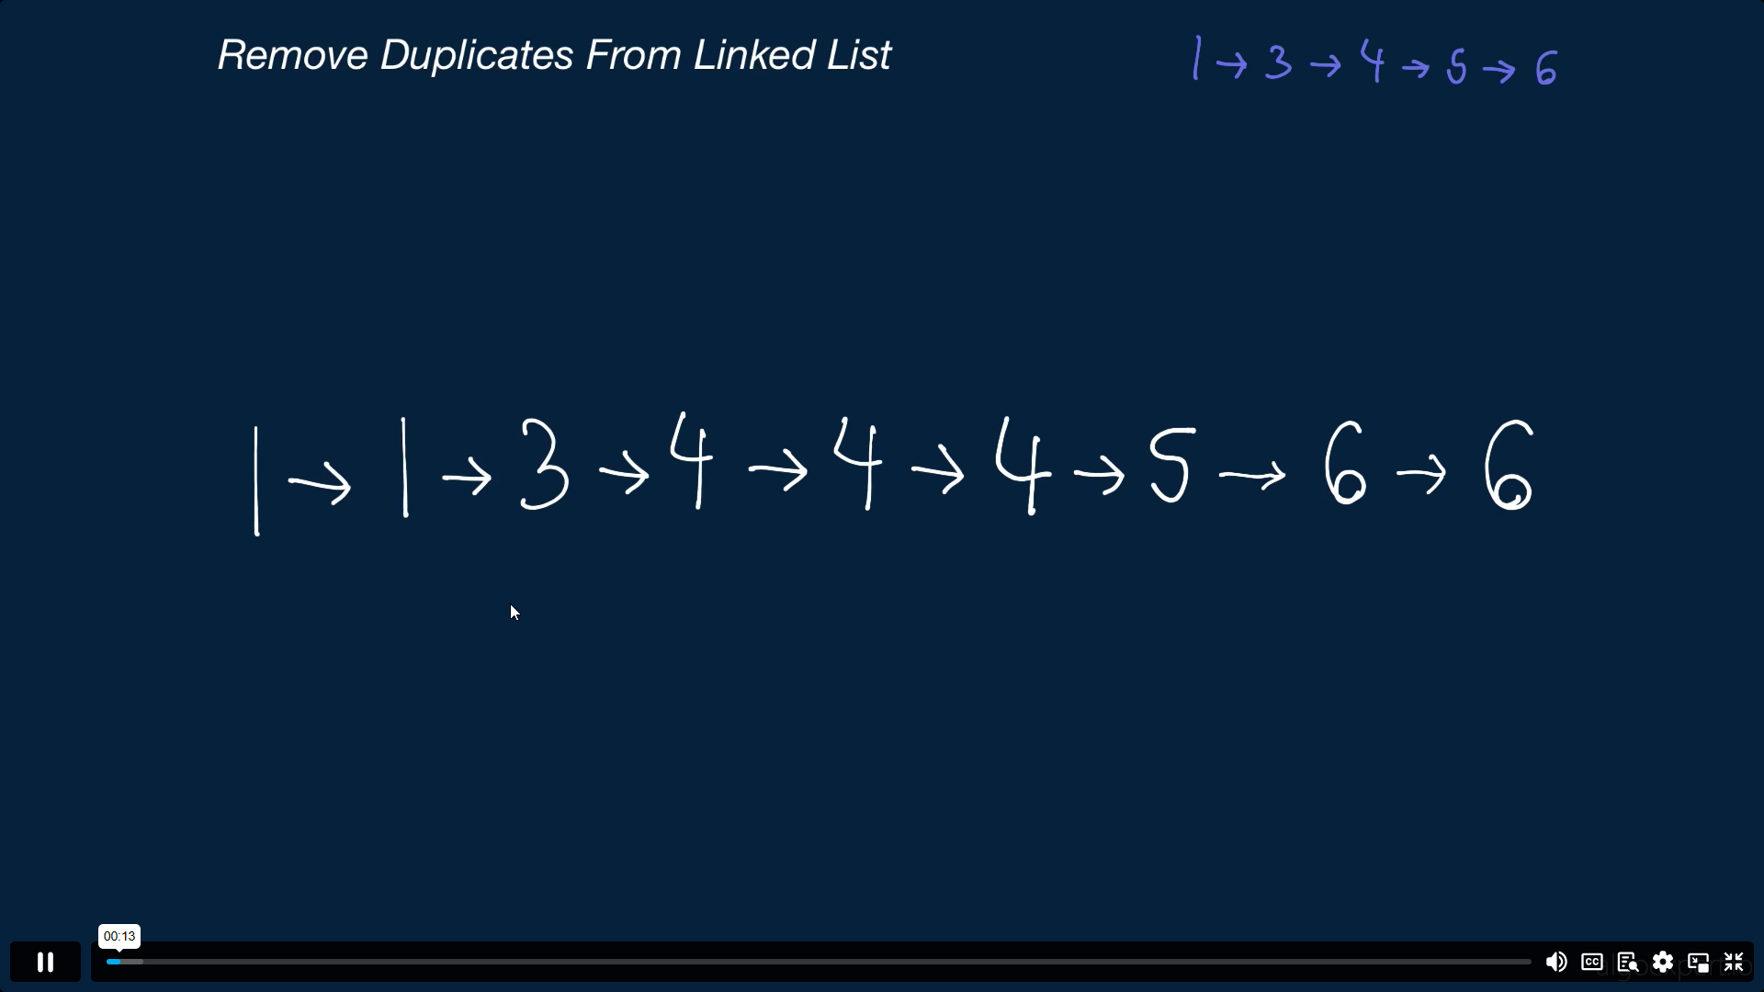

Slide 10
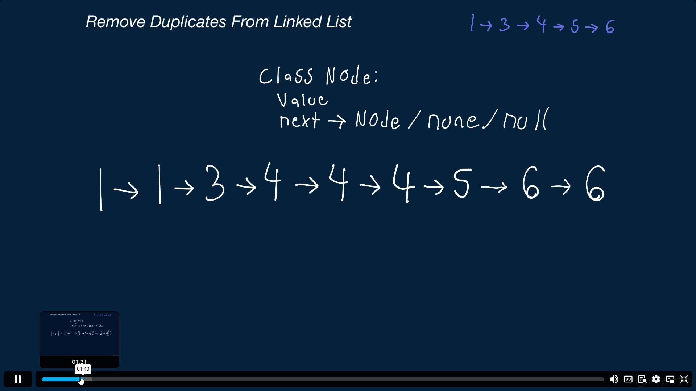

Slide 11
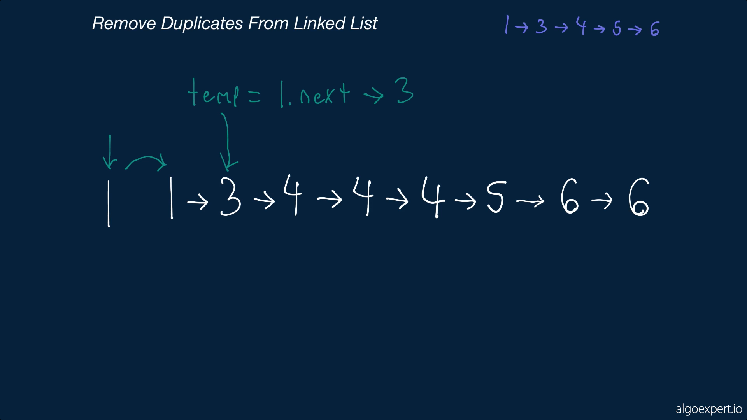

Slide 12
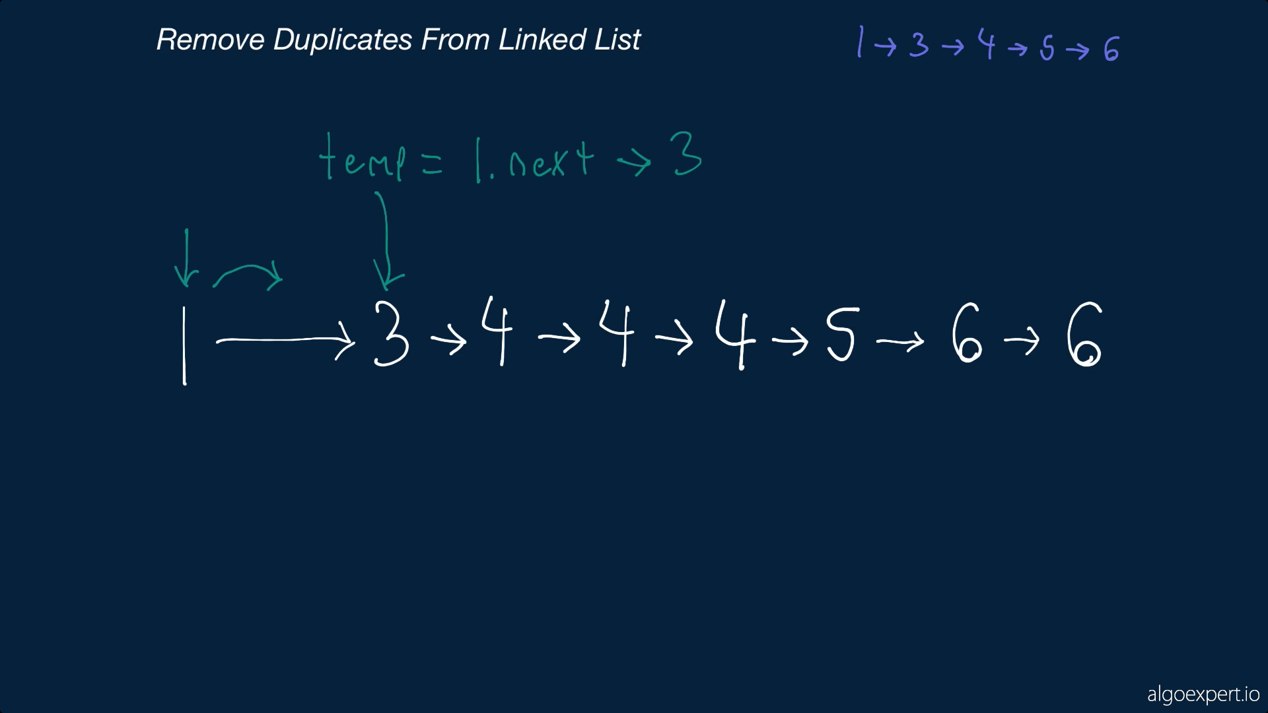

Slide 13
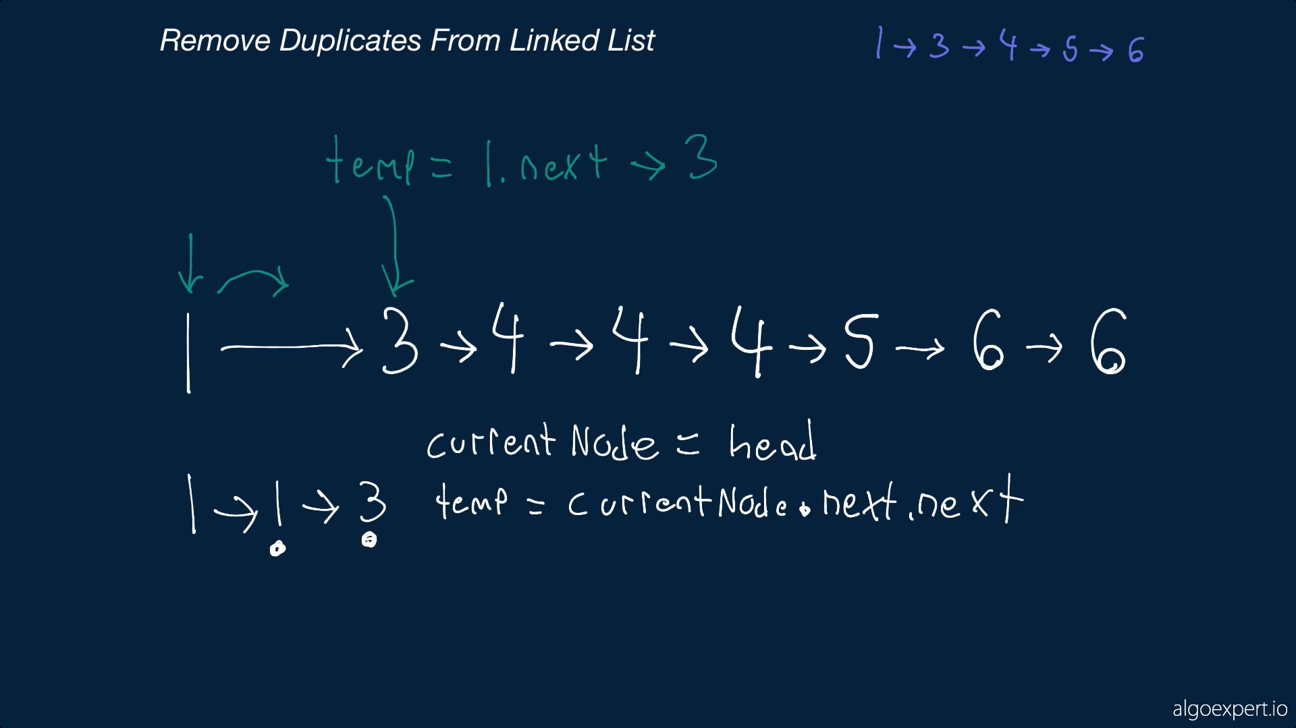

Slide 14
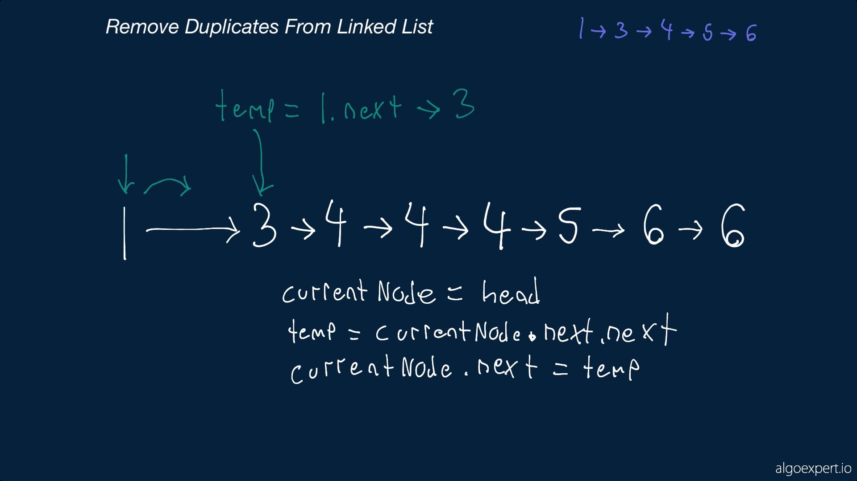

Slide 15
